Slide 1
Securing the Future of Open Source Computing
May 2022
Andrew Dellow - Huawei UK

Slide 2
Intrinsic Security
Root of Trust and Secure Boot
Standards and Certification
Security Ecosystem
Confidential Computing
Isolation
Attestation
Secure Storage
Life Cycle Management
Identity
Security as a basic feature of HW, SW Firmware
Support security through entire lifecycle
Published Guidelines matched to usage profiles

Slide 3
RISC-V Security Rationale
Clean-slate architecture invites new hardware security solutions
Open security model accelerates hardware security innovation
Opportunity to incorporate security industry learnings & best practices
Open governance facilitates collaboration on best security approach
Royalty free model enables new open-source hardware security solutions

Slide 4
Security Scope
Process
Standards Compliance, Security Incidence Response
Security Ecosystem
Firmware,
Software, and
Tools
Root-of-Trust, Secure Boot
Confidential Computing
Hardware
Security
Capabilities
Trusted Execution Environment
Memory Protection, Isolation
Crypto Acceleration
Control Flow Integrity
Side Channel Leakage Protection
Embedded
Application
Server
Processor Cores

Slide 5
Security Model
State Goals & Rationale for RISC-V Security
Defines Scope
Defines Threat Model
Derives Security Requirements
Generic Device Model

Slide 6
Security Ecosystem
Enablement of RISC-V security services & software
Identify and list key open-source security software and libraries
Develop RISC-V security reference implementation(s)
Identify, monitor, and influence applicable standards
Identify and liaison with applicable Security Certification entities

Slide 7
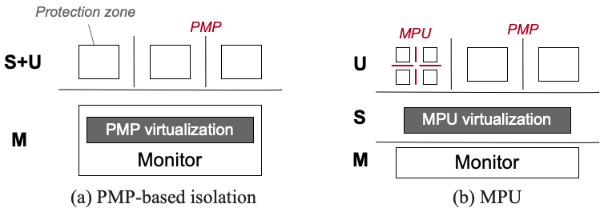
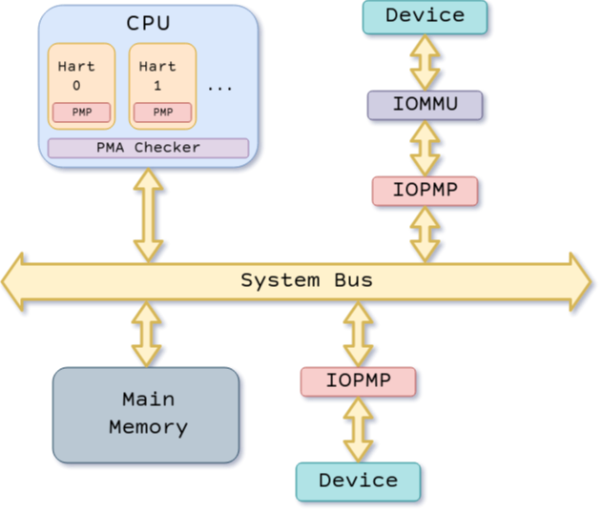
Memory Safety
PMP
Basic isolation between M-mode and S/U-modes.
ePMP
Enhanced PMP for increased executable protection, additional use cases
Virtual Memory
Isolation between S and U mode
Guest-Guest Isolation (VS-VS)
Host –Guest Isolation (HS-VS)
under development:
MPU
Similar to S-mode PMP
IOPMP
System Level PMP
Protects memory from other masters

Slide 8
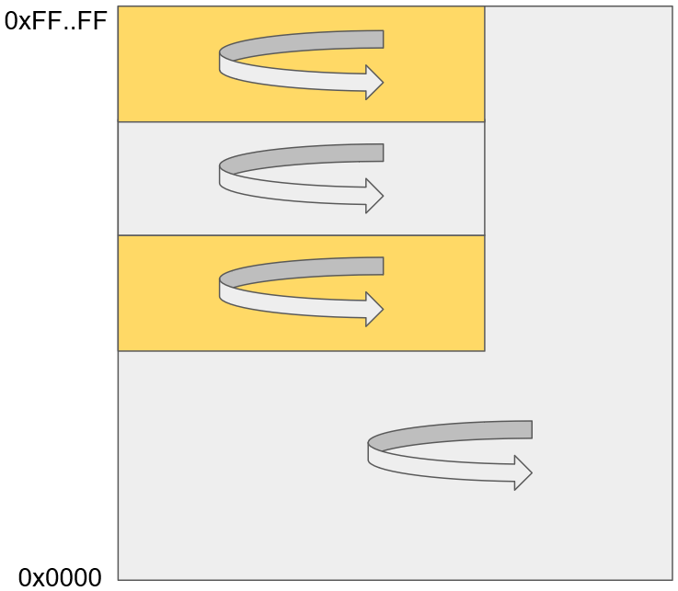
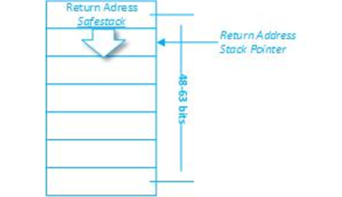
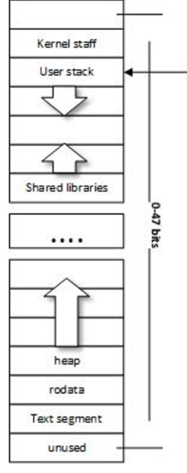
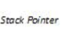


Robustness
Pointer Masking
actual_address = (requested_address & ~mpmmask) | mpmbase
Software based memory tagging
Memory bounding
under development:
Control Flow Integrity
Shadow Stack
Labelled Landing Pad
MicroArchitectural Side Channel Leakage
An anomaly
Speculation Barriers – fence.t

Slide 9
Cryptography
Scalar Extension Ratified
Vector Extension – 2022
Post Quantum – under discussion

Slide 10
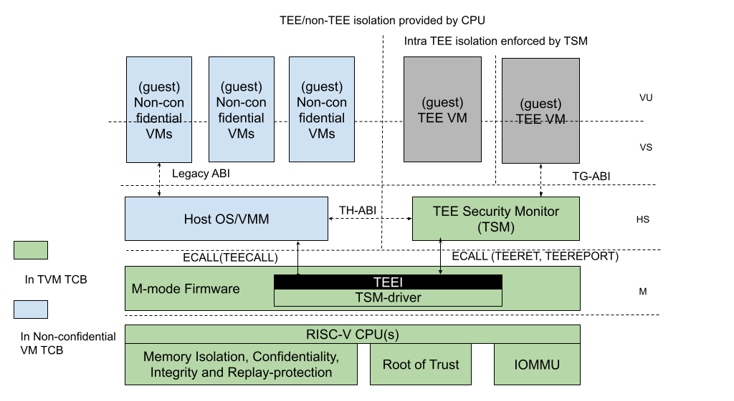
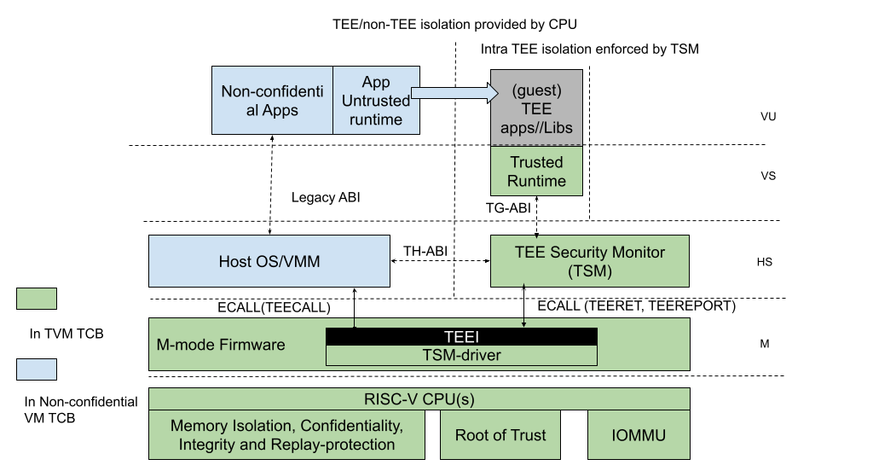
Trusted Computing
Conf. VMs, containers
Conf. apps, libraries
Under Development:
Trusted Execution Environment
APT TEE i/f to allow support on current ratified ISA
Extensions possible to improve performance, security etc
ABI interface
ISA interface
Maybe ISA affecting / ISA Affecting

Slide 11
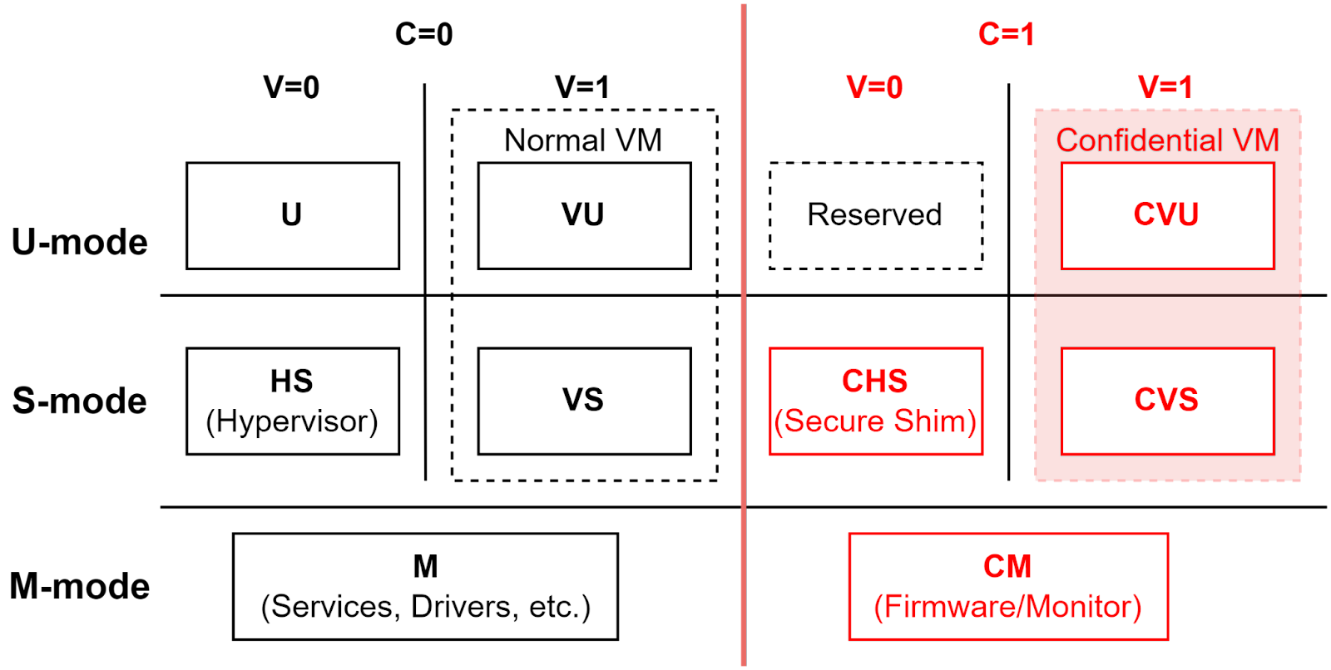
Trusted Computing (2)
Under Development:
Confidential Computing
Confidential VMs
Extension of APP TEE
Incorporate attestation standards
Maybe ISA affecting / ISA Affecting

Slide 12
Future Potential
Requirement Under discussion
Lightweight TEE
Potential Memory isolation scheme for small M/U systems.
Additional context to M mode
Capability Based Security
CHERI

Slide 13
SIRT
Ensure continuity of the RISC-V Security Incident Response Team (SIRT)
Institute and manage a responsible disclosure process
Triage incoming security disclosures
Maintain a catalogue of security issues

Slide 14
Status & Roadmap

Slide 15
Security HC - Roadmap
Security Incident Response Team
Security Model
Ecosystem, Reference implementations, etc.
Application-TEE, Confidential Compute, and Capabilities-Based
AP-TEE
Cap-Based TEE?
Control Flow Integrity (CFI)
CFI
Blockchain
Scalar Crypto
Vector Crypto
PQC Crypto
ePMP
Memory Safety
S-mode MPU
M-mode Isolation?
IOPMP
Pointer Masking (J extension)
Memory Tagging?
Microarchitectural Side Channel (uSC) leakage mitigations
uSC TG(s): Temporal Fencing and others (?)
2021
2022
2023
Sponsored SIG
Sponsored TG
HC work

Slide 16
Specification Plan
 | CY22-Q1 | CY22-Q2 | CY22-Q3 | CY22-Q4 | CY23-Q1 | CY23-Q2 | CY23-Q3 | CY23-Q4
Security Model (non-ISA)
AP-TEE (ISA + non-ISA)
CFI (ISA)
Vector crypto (ISA)
S-mode MPU (ISA)
IOPMP (non-ISA)
uSC leakage (ISA)
Inception
Plan
Develop
Freeze
Rat-Ready
Inception
Plan
Develop
Freeze
Rat-Ready
Inception
Plan
Develop
Freeze
Rat-Ready
Develop
Freeze
Rat-Ready
Inception
Plan
Develop
Freeze
Rat-Ready
Inception
Plan
Develop
Freeze
Rat-Ready
Inception
Plan
Develop
Freeze

Slide 17
RISC-V Security 5 year horizon
Platform Security Model outlining RISC-V security capacities and system’s integration
Tools and Software support for RISC-V security capabilities
Protection against side-channel information leakage at the hardware level
Robustness capabilities to prevent malicious manipulation of e.g., code execution flows
Cryptography support for small to large devices, including Post-Quantum Crypto
Memory isolation and Trusted Execution Environments to securely separate applications from each other
Support for Confidential Compute and Capability based models to enhance application and data privacy
Blockchain technology on RISC-V based systems

Slide 18
We need your help: Security@lists.riscv.org

